Slide 1
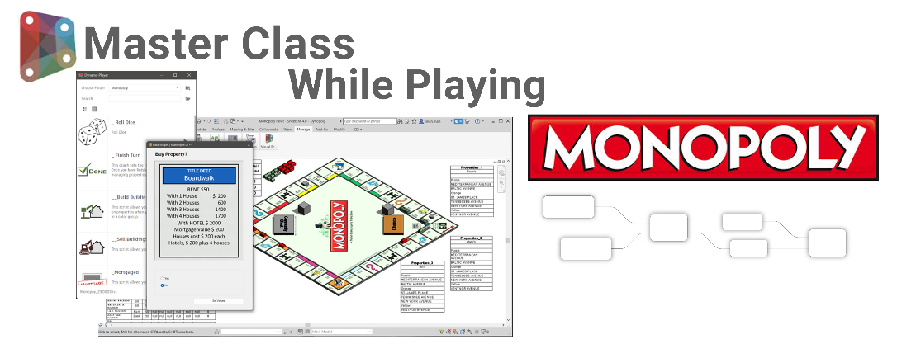








Company Logo
GitHub Repository
DIGITAL BUILT WEEK AMERICAS
JUNE 15-17, 2023 | DALLAS, TEXAS
Notes:
Sean
📖 Story - ?

Slide 2






Dynamo Master Class While Playing Monopoly
Speakers
Sean Fruin
IMEG
@SeanFruin
sigma-aec.com
CARL STORMS
BIM Track
@theBIMsider
thebimsider.com
Notes:
🔊Sean
Dynamo and Revit Experts
Michael
registered architect, writer & Smart guy
Making him the Archiest Smartest guy I know
Carl
Holds the World record for the most BiLT class submissions of all time
Me
½ mechanical Engineer & ½ developer
ADD Pushing the limits

Slide 3

Dynamo Master Class While Playing Monopoly
Learning Objectives
Deconstruct and program the game of Monopoly.
Discover the key Dynamo functionalities.
Provide an excellent resource for reference.
Notes:
🔊Sean
Computational Thinking
🚧 Deconstruct the Game of Monopoly
📝 Author Scripts
🪜 Dynamo functionalities
🎃 Many Tips Tricks along the way

Slide 4






Dynamo Master Class While Playing Monopoly
Agenda
Authoring
Best Practices
Dynamo
And Revit
Development
Strategies
Dynamo
UX/UI Design
Computational Geometry
Data
Analytics
Notes:
🔊Sean
🛩️ High Level Explore Dynamo
Functions
Workflows
Tips Tricks along the way

Slide 5

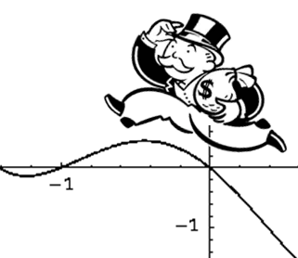

Dynamo Master Class While Playing Monopoly
Agenda – Bonus
Generative Design
Dynamo
Community
Notes:
🔊Sean
%20 Chance
Generative Design
Dynamo Community
Python. C#

Slide 6



Dynamo Master Class While Playing Monopoly
Why
Notes:
🔊Sean
🤔 Questions
🛑 Examples on next slides

Slide 7
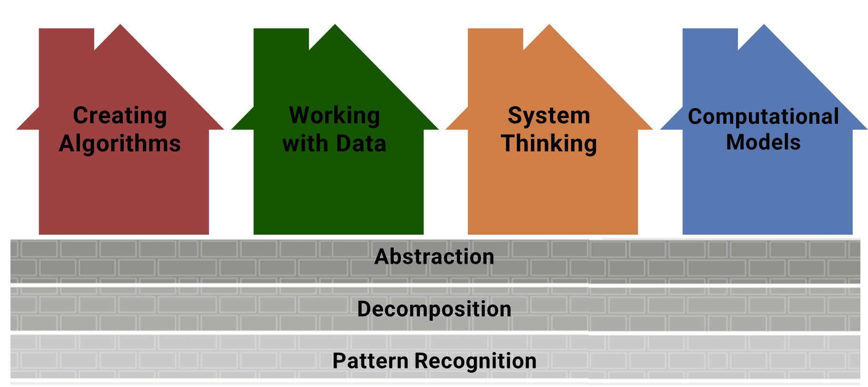
Dynamo Master Class While Playing Monopoly
Why – Computational Thinking
Notes:
🔊Sean
Computational Thinking - Computational thinking is recognized as a key skill set for all 21st century learners – whether they intend to continue with Computing Science or not.
Foundations
Abstraction
the process of identifying and representing only the most important parts of a system. When students order the steps of a process, sort things into categories, or any other technique to simplify a complex idea or system, they are creating an abstraction.
Decomposition
is closely related to abstraction, in that it is the process of breaking a system down into its component parts. This is a necessary step to be able to abstract these parts by selecting the most important elements, sorting them into categories, and placing them in a structured order.
Pattern
recognition is when we identify the arrangements and relationships between parts of a system or data set. Pattern recognition is key to identifying causes and correlations and ultimately allows us to make predictions about future behaviors of a system or component of a system.
Practices
Creating algorithms:
Whether coding a computer program or building a flowchart to share a complex process, algorithms can be used to represent procedures important to any subject.
Working with data:
Computation can support the collection, structuring, analysis, and presentation of data, allowing students more tools to investigate questions important to their learning.
Understanding systems:
Applying the computational thinking foundations give us a framework to break down and understand complex and dynamic systems, which can be made even more effective when we can use computational tools such as simulations to learn from.
Creating computational models:
Computational models and simulations help others understand systems and data. When students create new computational models they are applying not only all the computational thinking foundations but are also combining all the applied practices generate algorithms that allow a computer to represent our understanding of a system and the data that informs it.
Computational thinking is recognized as a key skill set for all 21st century learners – whether they intend to continue with Computing Science or not.
Computational Thinking can be grouped into four main areas:
Abstraction - seeing a problem and its solution at many levels of detail
Algorithms - thinking about tasks as a series of steps
Decomposition - understanding that solving a large problem will involve breaking it down into a set of smaller problems.
Pattern Recognition - appreciating that a new problem is likely to be related to other problems the learner has already solved.
Abstraction
Problem-solving approach that involves breaking down complex problems into smaller, more manageable parts.
Decomposition
In future AEC Workflows
Pattern Recognition
Clear Rules
Most have played
Algori
Logical Conditions
Exact locations of game items
🤹Required Skill and Processes
In future AEC Workflows
🎯Very Intuitive
Clear Rules
Most have played
🧩Complexities
Logical Conditions
Exact locations of game items
https://digitalpromise.org/initiative/computational-thinking/key-concepts-of-computational-thinking/
https://bimcorner.com/why-do-we-need-bim-standards-procedures-and-other-documents-in-a-company/

Slide 8
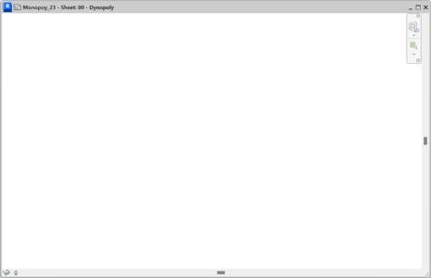

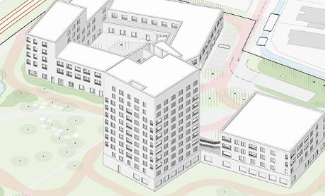
Dynamo Master Class While Playing Monopoly
Why – Similarities to BIM workflows
Notes:
🔊Sean
It is like BIM
🏢 Geometry
📅 Data / Data Structure
💻 Logic
For Example…

Slide 9
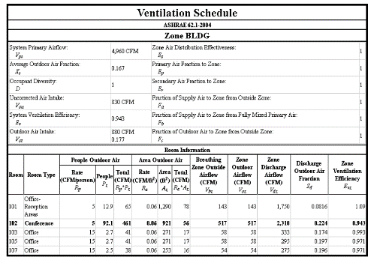
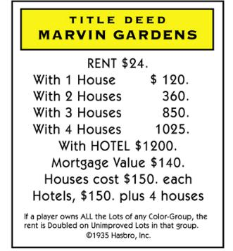

Dynamo Master Class While Playing Monopoly
Why – Organization of Data
Notes:
🔊Sean
Unstructured ➡️ Structured Data
📅Tables
Properties ➡️ ROWS
Parameters ➡️ Columns
Pattern recognition
looking for similarities among and within problems. Allows us to skip having to consider every individual concept and rather use previous experience and methods to efficiently and simultaneously deal with multiple objects and produce a re-usable solution.

Slide 10

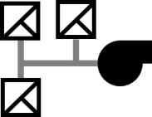

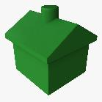
Dynamo Master Class While Playing Monopoly
Why – Data Structures
♾️ : 1
♾️ : 1
1 :♾️
Notes:
🔊Sean
Data Structures
Relational database - A collection of organized tables that is structured to facilitate efficient retrieval and manipulation of information.
🔑Primary Key - uniquely identifies each record in the table.
🔐2nd Key – Record relationships
1 : 1
1 : ♾️

Slide 11
Dynamo Master Class While Playing Monopoly
Why – Written Words to Logical Rules
Outlet Spacing in Kitchens
Monopoly “Go”
In kitchens, electrical outlets should be placed no farther than 48 inches apart, so that no point on the countertop is more than 24 inches away from a receptacle. Any countertop 12 inches wide or more should have an outlet on the wall behind the countertop.
Outlets should not be positioned higher than 20 inches above countertops, with certain exceptions for physically disabled persons and for islands or peninsulas where this height rule cannot be met.
Each time a player’s token lands on or passes over GO, whether by throwing the dice or drawing a card, the Banker pays him/her a $200 salary. The $200 is paid only once each time around the board. However, if a player passing GO on the throw of the dice lands 2 spaces beyond it on Community Chest, or 7 spaces beyond it on Chance, and draws the “Advance to GO” card, he/she collects $200 for passing GO the first time and another $200 for reaching it the second time by instructions on the card.
Notes:
🔊Sean
🧠 Knowledge Extraction
Natural Language ➡️ Logical Steps
Abstraction – focusing on the important information only, ignoring irrelevant detail. Abstraction allows us to create a general idea of what the problem is and how to solve it. The process instructs us to remove all specific detail and any patterns that will not help us solve our problem.

Slide 12


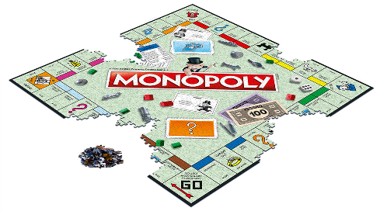
Dynamo Master Class While Playing Monopoly
Why – Easy Way to Learn
Very Intuitive
Surprisingly
Complex
Notes:
🔊Sean
Computational Thinking
Problem-solving approach that involves breaking down complex problems into smaller, more manageable parts.
🤹Required Skill and Processes
In future AEC Workflows
🎯Very Intuitive
Clear Rules
Most have played
🧩Complexities
Logical Conditions
Exact locations of game items
Just Have Fun With It
John has a great blog post about how having fun and doing things that might “seem like a waste of time” can in fact be the exact opposite!

Slide 13


Dynamo Master Class While Playing Monopoly
Why – Share What We Learned
github.com/
SigmaAEC/Dynopoly
Notes:
🔊Sean
🏫 I learned so much by setting this goal
🍻Share on GitHub
🤿 Deep dive
Learn
Future Reference
📢Show and tell
Inspire other

Slide 14

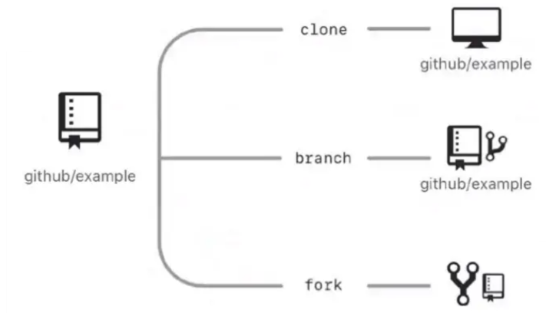

Dynamo Master Class While Playing Monopoly
What is GitHub?
8.7k results
Notes:
🔊Carl
GitHub
GitHub is a company that offers a cloud-based Git repository hosting service.
platform that’s been very popular with the coding community recently.
It’s an open-source code hosting site that helps developers store and manage their code.
It offers distributed version control through the Git system, as well as its source code management.

Slide 15

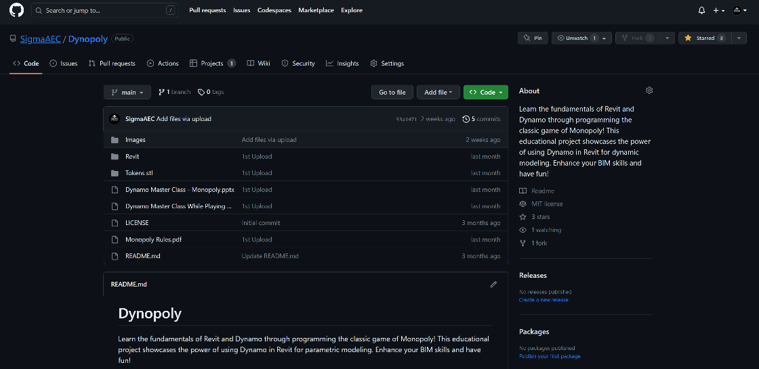
Dynamo Master Class While Playing Monopoly
GitHub’s Interface
Notes:
🔊Carl
What exactly does it do that makes it so popular?
To understand this, you need to know about the principles it relies upon:
version control
Git
What Is Version Control?
The class of systems that helps software developers track and manage changes to computer programs, websites, documents, or other data, is known as version control.
Developers constantly make improvements and changes to a software’s code after creating it. With every update, they come up with a new version of the software’s first officially released code.
The job of version control systems is to maintain these version updates by saving the changes in a central repository, that is, a location where all the files for a particular project are stored. This process makes it easier for developers to work together on the versions. They can download versions from the repository, change them, and re-upload the new version they’ve created. To keep track, these changes stored in the repository can be accessed by other developers at any point.
What Is "Git"?
As the name suggests, the version control system upon which GitHub is based is Git. Git is an open-source system created by Linus Torvalds, the creator of Linux, back in 2005. Back then, it began as a command-line tool in the Linux kernel.
More specifically, Git is a distributed version control system. It manages software versions just like other version control systems, using a central repository. The difference is that Git, as a distributed system, makes the repository available on every developer’s computer. This means that developers who use distributed version control actually retain a copy of the central repository by cloning it to their own machine.
This system works in a way that lets developers change their own local copies first, and after that, they register these changes to the central server. This procedure makes it easier to work with more detailed changes, because each time a developer wants to enact a change, it isn’t necessary to establish a connection to the server in order to do so. In this way, it also speeds up the working process, even though for developers who’ve always worked with other version control systems it can take some time getting used to.

Slide 16

Dynamo Master Class While Playing Monopoly
How To Download Dynamopoly
Notes:
🔊Carl
What exactly does it do that makes it so popular?
To understand this, you need to know about the principles it relies upon:
version control
Git
What Is Version Control?
The class of systems that helps software developers track and manage changes to computer programs, websites, documents, or other data, is known as version control.
Developers constantly make improvements and changes to a software’s code after creating it. With every update, they come up with a new version of the software’s first officially released code.
The job of version control systems is to maintain these version updates by saving the changes in a central repository, that is, a location where all the files for a particular project are stored. This process makes it easier for developers to work together on the versions. They can download versions from the repository, change them, and re-upload the new version they’ve created. To keep track, these changes stored in the repository can be accessed by other developers at any point.
What Is "Git"?
As the name suggests, the version control system upon which GitHub is based is Git. Git is an open-source system created by Linus Torvalds, the creator of Linux, back in 2005. Back then, it began as a command-line tool in the Linux kernel.
More specifically, Git is a distributed version control system. It manages software versions just like other version control systems, using a central repository. The difference is that Git, as a distributed system, makes the repository available on every developer’s computer. This means that developers who use distributed version control actually retain a copy of the central repository by cloning it to their own machine.
This system works in a way that lets developers change their own local copies first, and after that, they register these changes to the central server. This procedure makes it easier to work with more detailed changes, because each time a developer wants to enact a change, it isn’t necessary to establish a connection to the server in order to do so. In this way, it also speeds up the working process, even though for developers who’ve always worked with other version control systems it can take some time getting used to.

Slide 17


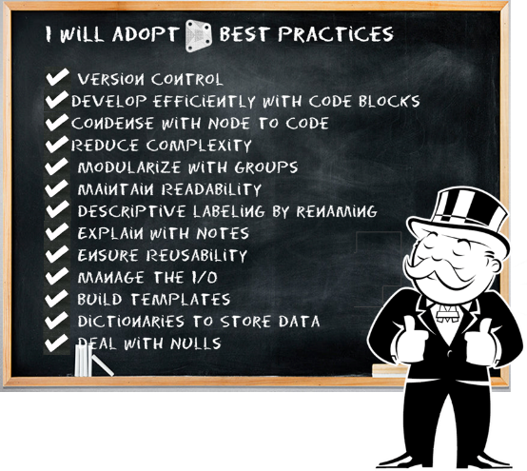

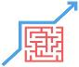

Dynamo Master Class While Playing Monopoly
Best Practices Check List
Stay Organized
Document
Reduce Complexity
Error Handling
Notes:
🔊Carl
Best Practices
Shed light on several strategies that we have learned,
Experience
Research
User Feed Back
Metric for quality:
Maintainability
Dependability
Usability
The principles are applicable to all programming environments and can inform many computational workflows.

Slide 18


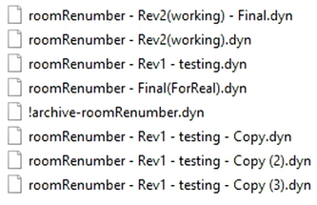
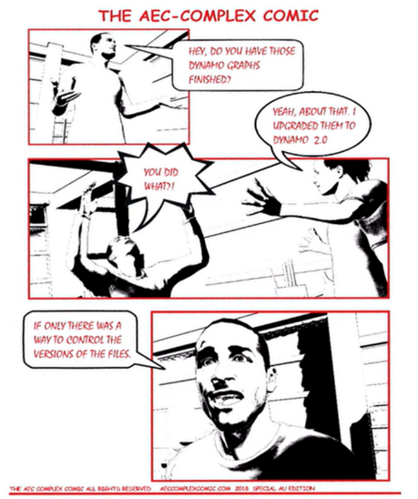

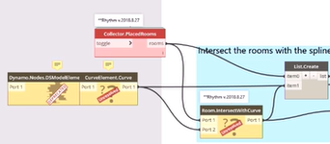
Dynamo Best Practices
Stay Organized - Version Control
Notes:
🔊Carl
Reference to Marcello’s comic about upgrading scripts to Dynamo 2.0
📂Sometimes We SUCK at Managing Files
📅But It Worked Yesterday!?
📖 Personal Story

Slide 19

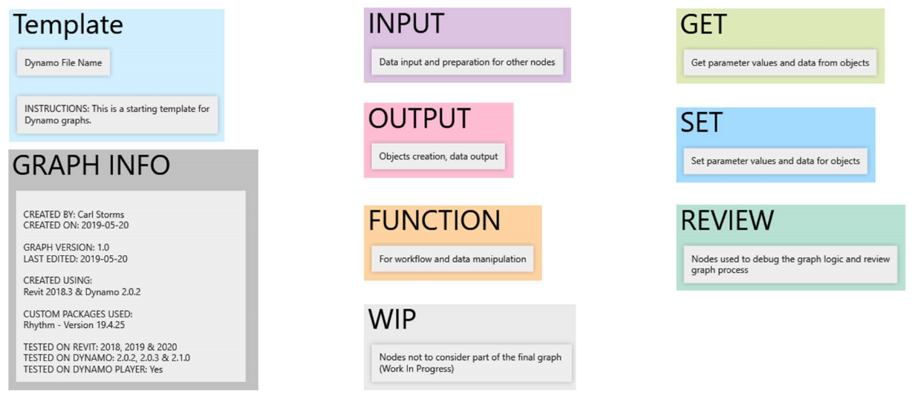
Dynamo Best Practices
Stay Organized – Create Template
Notes:
🔊Michael
Organize your Dynamo graphs using a template.
Modularize with Groups
Groups allow you to create functionally distinct parts as you build a program
Groups allow you to move large parts of the program around while maintaining modularity and alignment
You can change the color of the group to differentiate what Groups are doing (inputs vs functions)
You can use groups to start organizing your graph to streamline Custom Node creation
The colors in this program identify the purpose of each group. This strategy can be used to create hierarchy in any graphic standards or templates you develop.
Function group (blue)
Input group (orange)
Script group (green)

Slide 20

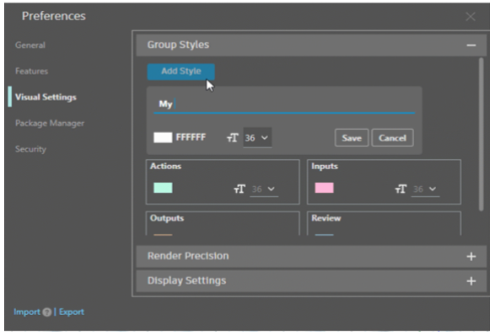
Dynamo Best Practices
Stay Organized – New Group Styles
Notes:
🔊Michael
Group styles allow you to define a name and color settings for your groups. Four default groups are provided: Actions, Inputs, Outputs, and Review. You can add more styles in Preferences Visual Settings. Apply these styles from the group context menu.

Slide 21

Dynamo Best Practices
Stay Organized – Pin Wires
Notes:
🔊Michael
Group styles allow you to define a name and color settings for your groups. Four default groups are provided: Actions, Inputs, Outputs, and Review. You can add more styles in Preferences Visual Settings. Apply these styles from the group context menu.

Slide 22

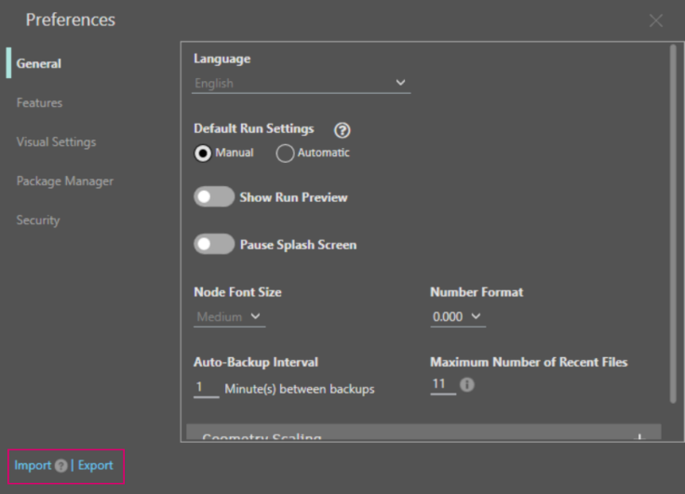
Dynamo Best Practices
Stay Organized - New Import/Export Settings
Notes:
🔊Michael
Help maintain office standards with settings import/export
Want to make sure that everyone at your company is using the same Dynamo settings? You’re now able to share and import settings with new options available from the splash screen (more on that below) and the Preferences panel.
From the splash screen, you can select Import Settings to apply the settings before Dynamo starts up. For more information on importing settings via the splash screen, check out the section below.
Settings will be exported as an XML file to the folder of your choice. When importing, keep in mind that your existing settings will be overwritten. If you want to maintain a copy of your current settings before importing new ones, first export your existing settings. For any settings that are not available in the Preferences panel, such as the default Dynamo window size, you’ll need to restart Dynamo (and any host program you may be running) before the imported settings take effect.
And on the topic of settings, we’ve added several new settings to help you customize your Dynamo experience further. In the Preferences panel, you’ll find the following new options.
Available under General:
Pause splash screen (more on the splash screen below)
Auto-backup interval
Maximum number of recent files: When reducing this number, keep in mind that any recent files above the chosen number will no longer be available in the Open Recent Files menu option or the Recent files list on the Dynamo landing page, until you open those files again.
Available under Features:
Custom Python template file path
Available under Visual Settings > Display Settings:
Enable hardware acceleration: Hardware acceleration can improve smoothness and overall performance by offloading work from central processing units (CPUs) to graphics display units (GPUs).
Each of the display settings now includes a tooltip to explain what the setting does.

Slide 23


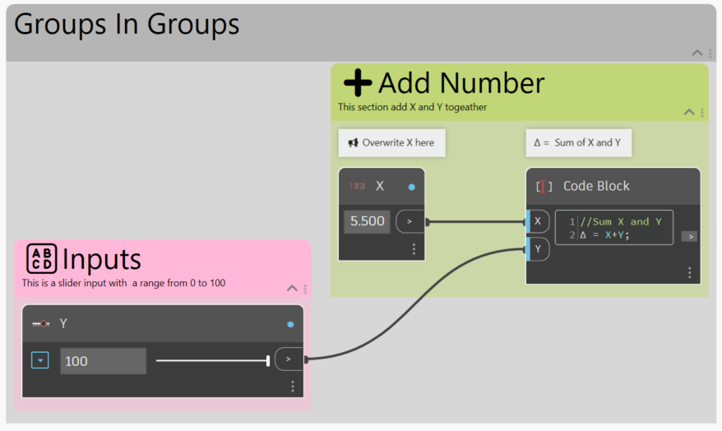







Dynamo Best Practices
Documenting - So Many Ways!
Group Title
Group Notes
Nested Groups
Node Rename
Add Note Box
Code Block Text
Emojis
Greek Letters
https://forums.autodesk.com/t5/community-conversations/
Notes:
🔊Michael
Groups now support nested groups officially
Tick- You can use Emoji and Greek Symbols
Comment Your Code
It is always best practice to comment your code, and this goes for Dynamo too. A few slashes (//) and a few words can be game changing in a few months when you open the graph again.
https://www.autodesk.com/autodesk-university/de/class/I-Shipped-My-Scripts-Awesome-Strategies-Sharing-Dynamo-Graphs-2022#handout

Slide 24

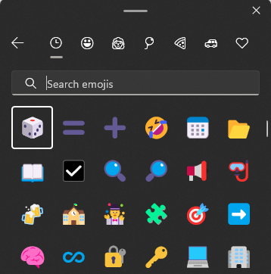
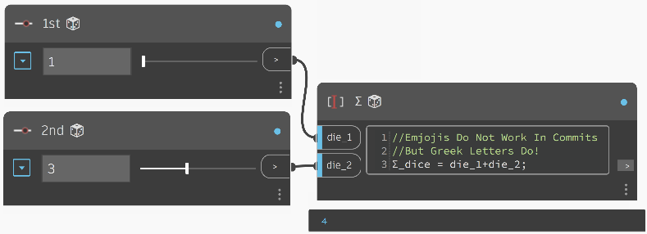
Dynamo Best Practices
Documenting – Emoji is worth A Few Of Words
Notes:
🔊Carl
Emojis to your Dynamo graphs .
Windows 10 keyboard tips and tricks.
Greek Symbols as variables?

Slide 25


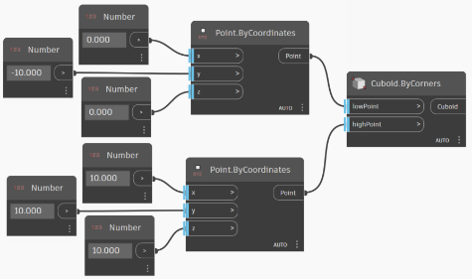
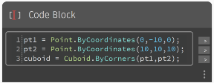

Dynamo Best Practices
Reduce Complexity - Code Blocks
Vs.
Notes:
🔊Carl
Develop efficiently with Code Blocks
DesignScript, the programming language at the heart of Dynamo
Benefits
Faster to write
Faster to execute
Easier to read
Better “If Statements”
Node to Code
Nodes can be automatically converted to text syntax to aid in learning DesignScript or simply to reduce the size of larger sections of graphs.

Slide 26
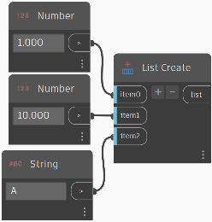
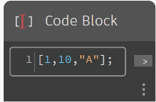
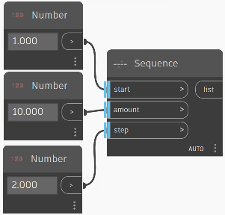
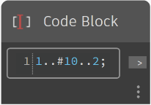
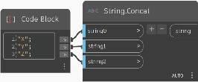
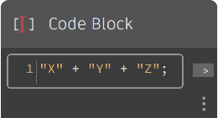
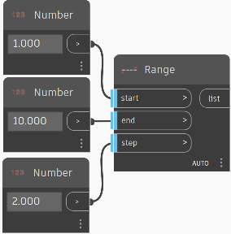
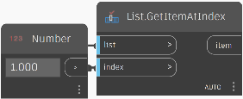
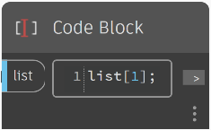
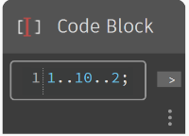
Conditional Statements
Create List
Dynamo Best Practices
Reduce Complexity - Code Blocks
Data Type
Standard
Node
Design Script
Sequences
Concatenate String
Get Item at Index
Ranges
Notes:
🔊Carl
Develop efficiently with Code Blocks
DesignScript, the programming language at the heart of Dynamo
Benefits
Faster to write
Faster to execute
Easier to read
Better “If Statements”
Node to Code
Nodes can be automatically converted to text syntax to aid in learning DesignScript or simply to reduce the size of larger sections of graphs.

Slide 27
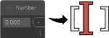
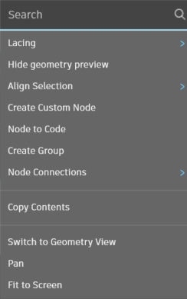



Dynamo Best Practices
How to - Node 2 Code
Left Click → Select Nodes
Right Click → Node to Code
Notes:
🔊Carl
Condense with Node to Code
You can reduce the complexity of a graph by using Node to Code which will take a collection of simple nodes and write their corresponding DesignScript in a single Code Block
Node to Code can condense code without eliminating the program’s clarity
The following are the pros of using Node to Code:
Easily condenses code into one component that is still editable
Can simplify a significant portion of the graph
Useful if the ‘mini-program’ will not often be edited
Useful for incorporating other code block functionality, like functions
The following are the cons of using Node to Code:
Generic naming makes it less legible
More difficult to understand for other users
No easy way to return to the visual programming version

Slide 28
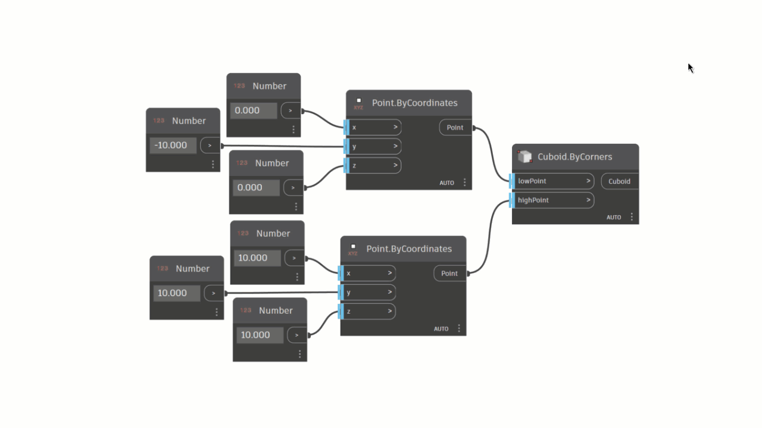
Dynamo Best Practices
How to - Node 2 Code
Notes:
🔊Carl

Slide 29

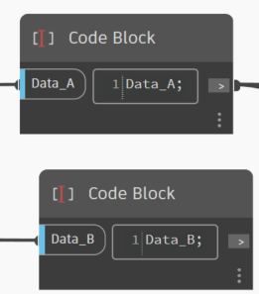
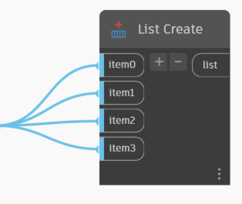



Dynamo Best Practices
Bouse Mouse Trick
+
Notes:
🔊Carl
Condense with Node to Code
You can reduce the complexity of a graph by using Node to Code which will take a collection of simple nodes and write their corresponding DesignScript in a single Code Block
Node to Code can condense code without eliminating the program’s clarity
The following are the pros of using Node to Code:
Easily condenses code into one component that is still editable
Can simplify a significant portion of the graph
Useful if the ‘mini-program’ will not often be edited
Useful for incorporating other code block functionality, like functions
The following are the cons of using Node to Code:
Generic naming makes it less legible
More difficult to understand for other users
No easy way to return to the visual programming version

Slide 30


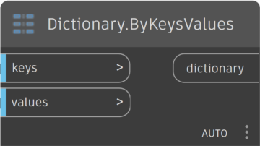
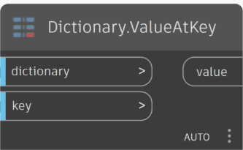
Dynamo Best Practices
Reduce Complexity - Dictionaries
Notes:
🔊Carl

Slide 31
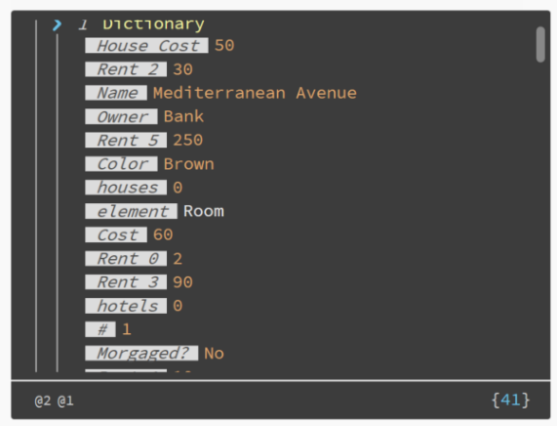


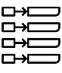
Dynamo Best Practices
Reduce Complexity - Dictionaries
Time Saving
Faster
Computation
Easier To
Access Data
Notes:
🔊Carl
Dictionaries in Dynamo
Dictionaries represent a collection of data that is related to another piece of data known as a key. Dictionaries expose the ability to search for, delete and insert data into a collection. Essentially, we can think of a dictionary as a really smart way to look something up.
Time Saving
Faster Computation
Easier to Access Data

Slide 32

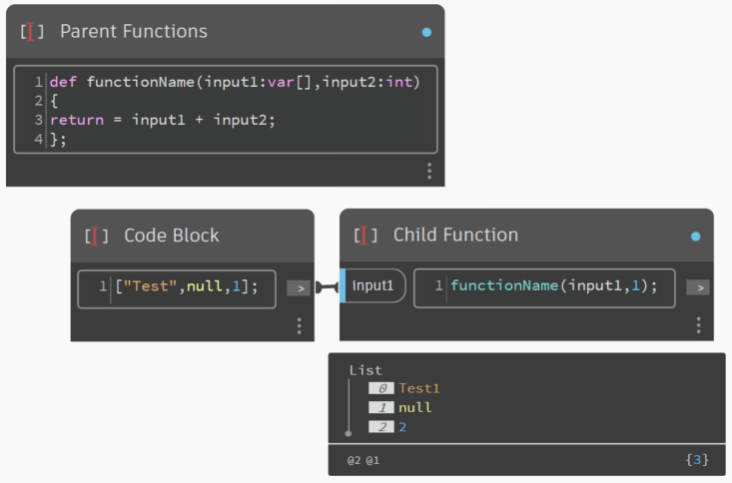
Dynamo Best Practices
Reduce Complexity - Function
Notes:
🔊Carl
Functions
This creates another layer of control in a parametric file, and can be viewed as a text-based version of a custom node. In this case, the "parent" code block is readily accessible and can be located anywhere on the graph. No wires needed!
created in a code block
recalled elsewhere in a Dynamo graph.
Parent
The first line has the key word “def”, then the function name, then the names of inputs in parentheses. Braces define the body of the function. Return a value with “return =”. Code Blocks that define a function do not have input or output ports because they are called from other Code Blocks.
Children
Call the function with another Code Block in the same file by giving the name and the same number of arguments. It works just like the out-of-the-box nodes in your library.

Slide 33
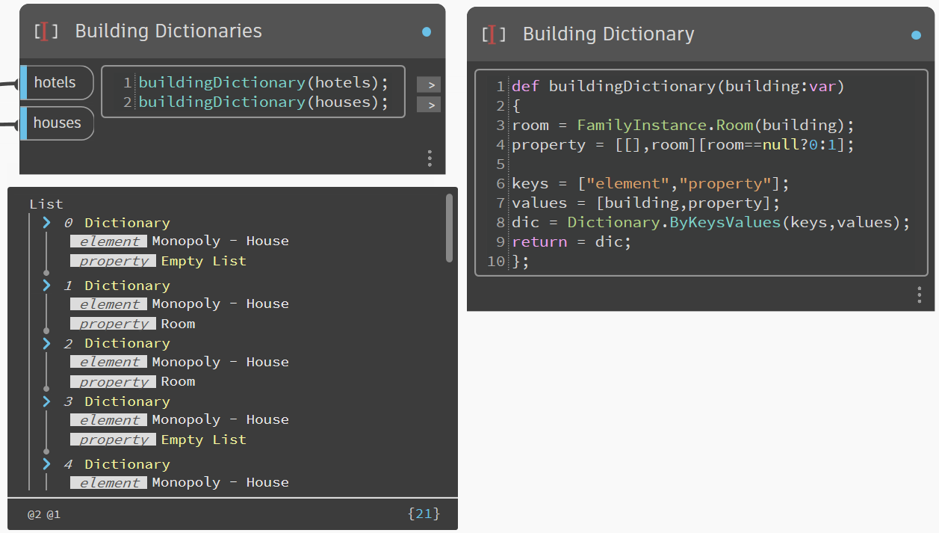
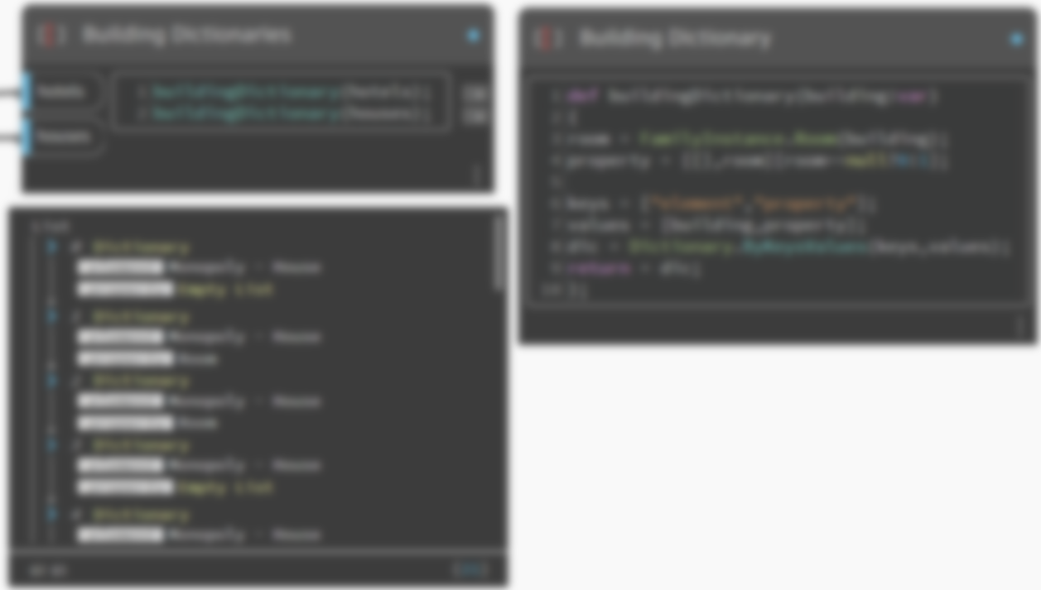
Dynamo Best Practices
Reduce Complexity - Function
Notes:
🔊Carl
Functions
This creates another layer of control in a parametric file, and can be viewed as a text-based version of a custom node. In this case, the "parent" code block is readily accessible and can be located anywhere on the graph. No wires needed!
created in a code block
recalled elsewhere in a Dynamo graph.
Parent
The first line has the key word “def”, then the function name, then the names of inputs in parentheses. Braces define the body of the function. Return a value with “return =”. Code Blocks that define a function do not have input or output ports because they are called from other Code Blocks.
Children
Call the function with another Code Block in the same file by giving the name and the same number of arguments. It works just like the out-of-the-box nodes in your library.

Slide 34



Dynamo Best Practices
Errors Are Frustrating
Notes:
🔊Carl
Story – Doing consultant work Sean Smashed a mouse once
Error handling is the process of responding to and recovering from error conditions in your program.
Inevitable with magnitude of data and geometry in AEC workflows

Slide 35
Dynamo Best Practices
Error- Function
Notes:
🔊Carl
Error handling is the process of responding to and recovering from error conditions in your program.
Inevitable with magnitude of data and geometry in AEC workflows

Slide 36
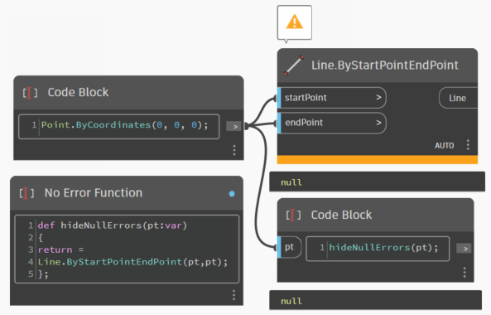
Dynamo Best Practices
Error- Mask with Function
Notes:
🔊Carl
Error handling is the process of responding to and recovering from error conditions in your program.
Inevitable with magnitude of data and geometry in AEC workflows

Slide 37
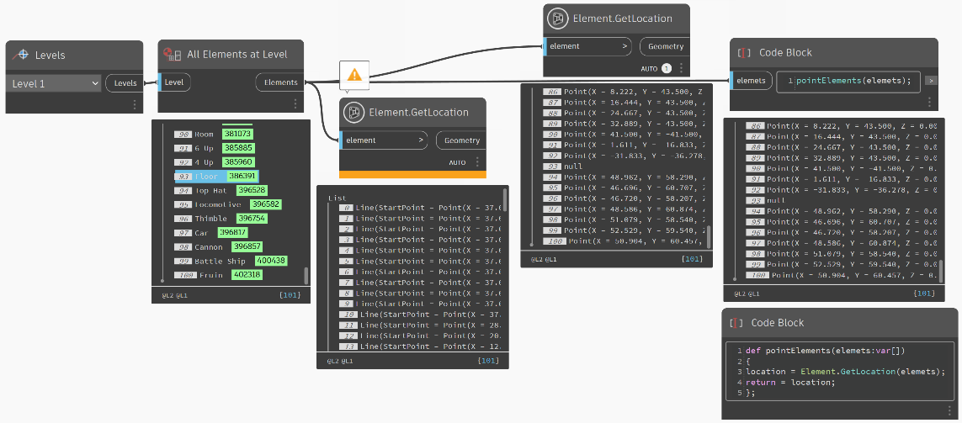
Dynamo Best Practices
Error- Function
Notes:
🔊Carl
Functions
This creates another layer of control in a parametric file, and can be viewed as a text-based version of a custom node. In this case, the "parent" code block is readily accessible and can be located anywhere on the graph. No wires needed!
created in a code block
recalled elsewhere in a Dynamo graph.
Parent
The first line has the key word “def”, then the function name, then the names of inputs in parentheses. Braces define the body of the function. Return a value with “return =”. Code Blocks that define a function do not have input or output ports because they are called from other Code Blocks.
Children
Call the function with another Code Block in the same file by giving the name and the same number of arguments. It works just like the out-of-the-box nodes in your library.

Slide 38
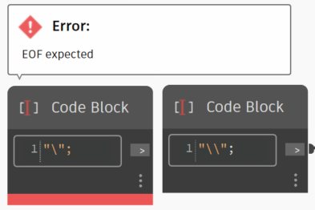
Dynamo Best Practices
Error – Can Not Do A “\” 🤷‍♂️
Notes:
🔊Michael
Functions
This creates another layer of control in a parametric file, and can be viewed as a text-based version of a custom node. In this case, the "parent" code block is readily accessible and can be located anywhere on the graph. No wires needed!
created in a code block
recalled elsewhere in a Dynamo graph.
Parent
The first line has the key word “def”, then the function name, then the names of inputs in parentheses. Braces define the body of the function. Return a value with “return =”. Code Blocks that define a function do not have input or output ports because they are called from other Code Blocks.
Children
Call the function with another Code Block in the same file by giving the name and the same number of arguments. It works just like the out-of-the-box nodes in your library.

Slide 39


Dynamo Best Practices
Errors - Check For & Remove Elements
Unexpected Geometry Type
Geometry Issues
Nulls
property = FamilyInstance.Room(building); propertyClean = [[],property][property==null?0:1];
Notes:
🔊Carl
Unexpected Geometry Type
Walls geometry is a point when a curve is expected – Use the Object Type Node To Check And Filter Out Unexpected Geometry Types
Geometry Issues
Room Boundaries are self intersecting.
Nulls
So many unknowns, test, test and test!

Slide 40


Dynamo Best Practices
Fast & Clean Element Data Collection
Notes:
🔊Carl
In the game scripts a function is used to gather parameter data and place the values in a dictionary.
Fast
Clean
Organized
Cleans errors

Slide 41








Dynamo Best Practices
Lists
Notes:
🔊Carl
Functions
This creates another layer of control in a parametric file, and can be viewed as a text-based version of a custom node. In this case, the "parent" code block is readily accessible and can be located anywhere on the graph. No wires needed!
created in a code block
recalled elsewhere in a Dynamo graph.
Parent
The first line has the key word “def”, then the function name, then the names of inputs in parentheses. Braces define the body of the function. Return a value with “return =”. Code Blocks that define a function do not have input or output ports because they are called from other Code Blocks.
Children
Call the function with another Code Block in the same file by giving the name and the same number of arguments. It works just like the out-of-the-box nodes in your library.

Slide 42






Dynamo Master Class While Playing Monopoly
Development Tips and Tricks
Notes:
🔊Sean

Slide 43




Development Tips and Tricks
Proper Planning Prevents Poor Performance
Mapped Out First
Jump Into Coding
Notes:
🔊Sean

Slide 44




Development Tips and Tricks
Kind of Like Baking Some Muffins
Notes:
🔊Sean

Slide 45


Development Tips and Tricks
Start With The End In Mind
Notes:
🔊Sean

Slide 46


Development Tips and Tricks
Start With The End In Mind
Title
You Landed On Boardwalk
Property Image
Option Buttons
Buy
Auction
Animation
➡️
Notes:
🔊Sean

Slide 47



Development Tips and Tricks
Get the Ingredients
Notes:
🔊Sean

Slide 48



Development Tips and Tricks
Get the Ingredients
Notes:
🔊Sean

Slide 49


Development Tips and Tricks
Then Fill In the Gaps
Notes:
🔊Sean

Slide 50

Development Tips and Tricks
MoSCow - Dynamopoly
Must-Have
Should-Have
Could-Have
Won't-Have
Properties
Roll Dice
Move Players
Money Exchange
Jail System
Houses and Hotels
Community Chest & Chance Cards
Multiplayer support
Trading System
Auction System
Animation
VR support
Visual Effect
Online Multiplayer
Dynamic Camera
Customizable game rules
Sound effects and music
Online Multiplayer support
Notes:
🔊Sean
MoSCoW – a simple yet powerful solution to set priorities both with and without timeboxes. However, it shows better efficiency if you have a certain deadline (BiLT 2023) for a task, feature, sub feature, functionality, etc. The framework is applicable to all levels of project prioritization from top to bottom, as well as to all functions and focus areas.
The MoSCoW abbreviation (except for the o’s) is carved with first letters of the priority categories it works with. These are Must-haves, Should-haves, Could-haves and Won’t-haves. And that’s how you can define which task falls into which category.
Must-haves
These are top-priority requirements, which shape the foundation of the major pipeline. Avoiding them means blocking the entire project or further activities. As a rule, product ideation depends entirely on defining must-haves using such pointers as ‘required for launch’, ‘required for safety’, ‘required for validation’, ‘required to deliver a viable solution’, etc.
Can we move forward with the project if this task is undone? – if NO, it’s MUST.
Should-haves
This type of requirement is of secondary priority. Should-haves do not affect the launch and, traditionally, are considered important but not crucial. They differ from must-haves by the availability of a workaround. Therefore, the failure of a should-have task is unlikely to cause the failure of the entire project. If you’re building a product, it will still be usable even if these requirements aren’t met.
Will we move forward with the project if this task is done a bit later? – if YES, it SHOULD.
Could-haves
The next requirement is less important than the two previous ones but still wanted. If we compare could-haves with should-haves, the former is defined by a lower degree of adverse effect if omitted. Traditionally, the third-level priority requirements in the Agile framework MoSCoW are realized if a project is not highly constrained in time. Within the product development, we can call them low-cost tweaks.
Can we sacrifice this task till the deadline? – if YES, it’s COULD.
Won’t-haves
These requirements define the lowest priority for tasks that are unviable to implement with a particular budget and deadline. Won’t-have does not mean a complete rejection of something. It envisions reintroduction under favorable conditions in the future.
Can we get back to it when things are going better? – if YES, it’s WON’T.

Slide 51


Development Tips and Tricks
Identify the Triforce
Notes:
🔊Sean

Slide 52










Development Tips and Tricks
Data
Monopoly “Go”
Each time a player’s token lands on or passes over GO, whether by throwing the dice or drawing a card, the Banker pays him/her a $200 salary. The $200 is paid only once each time around the board. However, if a player passing GO on the throw of the dice lands 2 spaces beyond it on Community Chest, or 7 spaces beyond it on Chance, and draws the “Advance to GO” card, he/she collects $200 for passing GO the first time and another $200 for reaching it the second time by instructions on the card.
Notes:
🔊Sean
Structured data
Predefined standardized format
Fixed field's structure
Complies to a data model
Follows a persistent order
Data points in the same group have the same attributes
Makes it easily to accessed by humans and programs.

Slide 53


Development Tips and Tricks
Knowledge Acquisition - Dynamopoly
Notes:
🔊Sean
Gif that scrolls though the rules.

Slide 54

Development Tips and Tricks
Knowledge Acquisition – Never That Simple
Luxury Tax is called Super Tax in the UK
Before the September 2008 graphic redesign of the game, the tax was $75.
This was increased to $100 after the redesign.
It was increased to $220 in the January 2022 graphic redesign of the game.
$220
$100
Notes:
🔊Sean
More Knowledge issues
Reginal naming
Revisions

Slide 55


Development Tips and Tricks
Knowledge Acquisition – Damn Millennials
As of September 2008, the new regular Monopoly U.S. version games only have the $200 Income Tax, excluding the 10 percent option.
Notes:
🔊Sean
Another rule changes
I think because of this guy!

Slide 56
Development Tips and Tricks
Knowledge Acquisition – Interpretation
Your total worth is all your cash on hand, printed prices of mortgaged and unmortgaged properties and cost price of all buildings you own.
TenPercentTax = Int(0.1 * (Player Money + Property Mortgages))
To do this you add up your cash in the normal way, add the property value by using the printed price of all unmortgaged property and mortgaged value of any mortgaged properties, and finally, you add the value of your buildings by using the printed price of all your houses and hotels.
Notes:
🔊Sean
Another rule changes
I think because of this guy!

Slide 57
Development Tips and Tricks
Knowledge Acquisition – Hard to Keep Track
68%
Of Americans admit they’ve never read the official MONOPOLY rules in their entirety.
49%
Of Americans admit they’ve made up a MONOPOLY rule.
77%
Of Americans admit they’ve enforced fake MONOPOLY rules.
Notes:
🔊Sean
Have some fun with the attendees with this slid. The point is illustrate that every tends to have their own process.
Question
Anyone have any Special House rules?
Knowledge Acquisition is normally no clear cut.
For example, these custom house rules.

Slide 58
Development Tips and Tricks
Knowledge Acquisition – Finicky Rules
HOUSE RULE
BY THE BOOK
HOUSE RULE
BY THE BOOK
All taxes and finds are put in pot and whoever land on Free Parking first get the money.
Nothing happens when a player lands on Free Parking.
You can not collect rent while in jail.
You do collect rent while in jail.
HOUSE RULE
BY THE BOOK
HOUSE RULE
BY THE BOOK
If a player land on a property and dose not want to buy it, it is the next player turn.
If a player doesn't want to buy it, the property immediately up for auction.
You must make one full rotation around the board before you can start buying.
You can start buying properties right out the gate.
Notes:
🔊Sean
Have some fun with the attendees with this slid. The point is illustrate that every tends to have their own process.
Question
Anyone have any Special House rules?
Knowledge Acquisition is normally no clear cut.
For example, these custom house rules.

Slide 59

Development Tips and Tricks
Data
Notes:
🔊Sean
Structured data
Predefined standardized format
Fixed field's structure
Complies to a data model
Follows a persistent order
Data points in the same group have the same attributes
Makes it easily to accessed by humans and programs.

Slide 60


Development Tips and Tricks
Data - Revit Setup
Notes:
🔊Sean
Structured data
Predefined standardized format
Fixed field's structure
Complies to a data model
Follows a persistent order
Data points in the same group have the same attributes
Makes it easily to accessed by humans and programs.

Slide 61


Development Tips and Tricks
Image Data
Notes:
🔊Sean
Simi structured data
Organized images and gifs
File name is the key for form the relationships.

Slide 62


Development Tips and Tricks
Data Structure – Relational Database
Notes:
🔊Sean
Conceptual database schema:
This is a high-level overview of what your database will contain, how the data will be organized and the rules the data will follow. This type of schema is created in the initial project stage.
A conceptual schema focuses on the main concepts and their relationships. It doesn’t dig into any of the details and is thus insufficient to build a database.

Slide 63

Development Tips and Tricks
Token Parameters
Name | Type | VISIBLE | Tool Tip
monopoly_Number | Integer | 1 | Player number used to tack turns.
monopoly_Name | String | 1 | Player entered name.
monopoly_Jail Turns | Integer | 0 | Track number of turns spent in jail
monopoly_Doubles Cnt | Integer | 0 | Track number of time doubles have been rolled.
monopoly_Position | Integer | 0 | Track player's current position on the board.
monopoly_Money | Integer | 1 | Track player's current cash
monopoly_Out Card | Integer | 1 | Track number of "Get Out of Jail Free" card.
monopoly_Turn | Boolean | 1 | Set True if it is the players turn to make a move selection.
Notes:
🔊Sean
Parameters
Data Type
Hidden Parameters
Tool Tip
Physical database schema: A physical schema combines contextual and logical information while adding technical requirements. It contains the syntax needed to create data structures within the disk storage.
Both logical and physical schemas include a primary key that serves as a unique identifier for every entry in the table.

Slide 64



Development Tips and Tricks
Token Parameters – Set Hidden Properties
Notes:
🔊Sean

Slide 65



Development Tips and Tricks
Parameters Tool Tips
Notes:
🔊Sean
Tool Tip
Description
How it is set w/ Dynamo

Slide 66

Development Tips and Tricks
Property (Room) Parameters Keys
Notes:
🔊Sean

Slide 67



Development Tips and Tricks
Computation

Slide 68

Development Tips and Tricks
Computation
Notes:
🔊Sean

Slide 69



Dynamo Master Class While Playing Monopoly
Dynamo For Revit
Notes:
🔊Michael
While Dynamo is a flexible environment, designed to port into a wide range of programs, it was originally created for use with Revit. A visual program creates robust options for a Building Information Model (BIM). Dynamo offers a whole suite of nodes specifically designed for Revit, as well as third-party libraries from a thriving AEC community. This chapter focuses on the basics of using Dynamo in Revit.
Revit hosts a comprehensive API (Application Program Interface), allowing third-party developers to create custom tools. And programmers have been using this API for years, but text-based scripting isn't accessible to everyone. Dynamo seeks to democratize Revit data through an approachable graphical algorithm editor.
Using the core Dynamo nodes in tandem with custom Revit ones, a user can substantially expand parametric workflows for interoperability, documentation, analysis, and generation. With Dynamo, tedious workflows can be automated while design explorations can thrive.
Since Dynamo was originally created for AEC, its large and growing community is a great resource for learning from and connecting with experts in the industry. Dynamo’s community is made of architects, engineers, programmers, and designers who all have a passion for sharing and making.
Dynamo is an open-source project that is constantly evolving, and a lot of development is Revit-related. If you're new to the game, get on the discussion forum and start posting questions! If you're a programmer and want to get involved in Dynamo's development, check out the github page. Also, a great resource for third-party libraries is the Dynamo package manager. Many of these packages are made with AEC in mind, and we'll take a look at third-party packages for panelization in this chapter.

Slide 70












Dynamo and Revit
Revit Hierarchy and Structure
Generic Model
Family
Sean
Type
Instance
Notes:
🔊Sean
o select Revit elements properly, it's important to have a full-understanding of the Revit element hierarchy. Want to select all the walls in a project? Select by category. Want to select every Eames chair in your mid-century modern lobby? Select by family. Before jumping into an exercise, let's do a quick review of the Revit hierarchy.

Slide 71



Dynamo And Revit
Revit Create Elements
Notes:
🔊Sean
o select Revit elements properly, it's important to have a full-understanding of the Revit element hierarchy. Want to select all the walls in a project? Select by category. Want to select every Eames chair in your mid-century modern lobby? Select by family. Before jumping into an exercise, let's do a quick review of the Revit hierarchy.

Slide 72



Dynamo and Revit
Dynamo For Revit
Notes:
🔊Sean
Revit is a data-rich environment. This gives us a range of selection abilities which expands far beyond "point-and-click". We can query the Revit database and dynamically link Revit elements to Dynamo geometry while performing parametric operations.

Slide 73


Dynamo and Revit
Select Revit Elements
Notes:
🔊Sean

Slide 74

Dynamo And Revit
Select Revit Elements
Notes:
🔊Sean

Slide 75




Dynamo And Revit
Collect Revit Elements
Notes:
🔊Sean

Slide 76


Dynamo And Revit
Select Revit Elements
Notes:
🔊Sean
Revit is a data-rich environment. This gives us a range of selection abilities which expands far beyond "point-and-click". We can query the Revit database and dynamically link Revit elements to Dynamo geometry while performing parametric operations.

Slide 77


Dynamo and Revit
Collect Revit Elements
Notes:
🔊Sean
Use the Dynamo player as an input for users to specify between more than two options by creating a list and getting the item of the list with a number slider as the input.

Slide 78





Dynamo and Revit
Revit Families From Dynamo Geometry
Notes:
🔊Sean

Slide 79







Dynamo And Revit
Revit Create Elements
Notes:
🔊Sean

Slide 80

Dynamo and Revit
Revit Families From Dynamo Geometry
Notes:
🔊Sean

Slide 81


Dynamo and Revit
Make Floors, Walls and Rooms
Notes:
🔊Sean

Slide 82


Dynamo and Revit
Make Floors, Walls and Rooms
Notes:
🔊Sean

Slide 83

Dynamo and Revit
Make Revit Schedules
Notes:
🔊Sean

Slide 84



Dynamo and Revit
Mesh to Revit Family
Notes:
🔊Sean

Slide 85


Dynamo and Revit
Query Revit Stuff
Notes:
🔊Sean

Slide 86


Dynamo and Revit
Query Revit Stuff
Notes:
🔊Sean

Slide 87


Dynamo Master Class While Playing Monopoly
Computational Geometry
Shapes
Size
Position
Space
Transformation
Notes:
🔊Sean
Geometry is the language for design
Dynamos geometry kernel
easy to calculate the result of complex geometric interactions

Slide 88


Computational Geometry
Geometric Primitives
Notes:
🔊Sean

Slide 89


Computational Geometry
Building Geometry – Connect the Dots
Notes:
🔊Sean

Slide 90

Computational Geometry
Building Geometry – Connect the Dots
Point.ByCoordinates
P4
P2
P3
P0
P1
Notes:
🔊Sean

Slide 91

Computational Geometry
Building Geometry – Connect the Dots
Point.ByCoordinates
PolyCurve.ByPoints
Notes:
🔊Sean

Slide 92

Computational Geometry
Building Geometry – Connect the Dots
Point.ByCoordinates
PolyCurve.ByPoints
Surface.ByPatch
Notes:
🔊Sean

Slide 93



Computational Geometry
Building Geometry – Connect the Dots
Point.ByCoordinates
PolyCurve.ByPoints
Surface.ByPatch
Geometry.Mirror
Notes:
🔊Sean

Slide 94


Development Tips and Tricks
Building Geometry – Connect the Dots
Point.ByCoordinates
PolyCurve.ByPoints
Surface.ByPatch
Geometry.Mirror
Surface.Thicken
Notes:
🔊Sean

Slide 95

Computational Geometry
Building Geometry – Connect the Dots
Point.ByCoordinates
PolyCurve.ByPoints
Surface.ByPatch
Geometry.Mirror
Surface.Thicken
Point.ByCoordinates
Notes:
🔊Sean

Slide 96


Development Tips and Tricks
Building Geometry – Connect the Dots
Point.ByCoordinates
PolyCurve.ByPoints
Surface.ByPatch
Geometry.Mirror
Surface.Thicken
Point.ByCoordinates
Cylinder.ByPointsRadius
Notes:
🔊Sean

Slide 97


Computational Geometry
Building Geometry – Connect the Dots
Point.ByCoordinates
PolyCurve.ByPoints
Surface.ByPatch
Geometry.Mirror
Surface.Thicken
Point.ByCoordinates
Cylinder.ByPointsRadius
Solid.ByUnion
Notes:
🔊Sean

Slide 98




Computational Geometry
Board Geometry – Range & Sequences
Notes:
🔊Sean
there are 40 spaces around the board, which I've indexed as 0 through 39 (where 0 is Go and 39 is Boardwalk)
' I've added a 41st space (but since we're in base 0 it's really the 40th space) to account for jail
' so space 10 is "Just Visiting" the jail and space 40 is "In Jail"

Slide 99

Computational Geometry
Board Geometry – Range & Sequences
Notes:
🔊Sean
A Key concept that pops up all the line in workflows is Range and Sequence
Range
Range will produce a list of numbers between the specified Start and End inputs.
The numbers will increase from the Start input according to the Step.
In the example, we start with 1 and end with 25.
Sequence
Sequence will produce a list of numbers.
The list begins at the Start input, and then increments by the Step input.
The Amount input determines the number of items in the list.

Slide 100







Computational Geometry
Board Geometry – Range & Sequences
Notes:
🔊Sean

Slide 101





Computational Geometry
Card Shuffle – Normal Vectors & Rotation
$$n= \left[\begin{matrix}x \\ y \\ z\end{matrix}\right]$$
Notes:
🔊Sean
If you have a curve, placing a vector and showing its direction normal (perp) to your curve reveals a lot about the local behavior of your curve, including what direction the curve would offset when you need to move the curve. There are many other ways to show the orientation and normal vector to a curve. This is just one method.
Also, OOTB Dynamo does not show a physical representation of a vector so using a single straight line to represent the vector is helpful to visualize the abstract vector.
The question is why, when creating a vector in dynamo, it does not display. However dynamo will display a plane and IMHO that is just as abstract as a vector. Oh well. Let us not wait for that to happen and use the method above to visualize that vector!

Slide 102



Computational Geometry
Place Tokens On Properties
Notes:
🔊Sean

Slide 103


Computational Geometry
Place Tokens On Properties
Notes:
🔊Sean

Slide 104







Computational Geometry
Random Dice Locations
Notes:
🔊Sean
The two dice to land in random locations on the board and at a random angle.
The Dice can NOT intersect the buildings, player tokens, chance cards or each other.
Looping Definition

Slide 105




Computational Geometry
Place Houses & Hotels On Property
Notes:
🔊Sean

Slide 106


Computational Geometry
Place Houses & Hotels On Property
Nearest Line to Floor Center
Series of points along Nearest Line
count Number of House on Property
Get the point at the index of House count
+ ½ House Width
P = [0, 0.2, 0.4, 0.6, 0.8]
Notes:
🔊Sean

Slide 107


Computational Geometry
Random Dice Locations
Notes:
Defines X and the resulting point count as 0 and starts a loop
Adds one to X
Creates as many random points as you request on a surface
Removes any which don’t touch the surface
Prunes out any points which are closer than the desired separation distance.
If X is equal to 500 or the resulting point list is equal to or greater than the desired point count then terminates the loop.
Pulls a number of points equal to the request count from the list (to prevent over population)
Returns the number of iterations used, if the count was hit, and the points produced after trimming excess results.

Slide 108









Computational Geometry
TuneUp Extension
Compare operations execution times
Home in on problem areas in graphs
Check execution time of your entire graph
Explore how delta-compute functions works
Notes:
🔊Sean
TuneUp is a profiling extension that logs how long each node takes to run and expresses that information in the Dynamo Sidebar. Capturing the runtime of nodes in TuneUp has been built on the back of work done in early 2019 to understand what affect that changes we make to Dynamo have on the performance of the overall system. We use these profiling operations internally to make sure that Dynamo gets faster, more performant and more streamlined over time – and we wanted to build an extension that allowed you, the graph creators, to have the exact same potential with your graphs!
Basically, we wanted to share the awesomeness that understanding brings in allowing you to target the inefficiencies in your graph creation, and this allows you to:
Hone in on problem areas to build more efficient graphs
Understand what kind of operations take a longer time to execute
See the overall execution time of your entire graph
Explore how delta-compute functions inside of Dynamo
TuneUp is accessible on the Package Manager when you search for TuneUp for the release of our MVP (Minimum viable product).
You can find the TuneUp extension under the view menu and after selecting the menu item, TuneUp will appear in the right-hand Sidebar window and contains a bunch of features which we will go through in a minute.
The location of TuneUp, accessible via theView menu and then selecting: Show TuneUp
The TuneUp extension, housed in the sidebar panel
https://dynamobim.org/tuneup-extension-explore-your-node-and-graph-execution-times/

Slide 109

Computational Geometry
TuneUp Extension
Notes:
🔊Sean

Slide 110


Computational Geometry
TuneUp Extension
Notes:
🔊Sean

Slide 111


Computational Geometry
Faster Then Light Method!
Notes:
🔊Sean
This node is designed to capture the output of any node and cache the results in the .dyn file when the graph is saved.This node is designed to capture the output of any node and cache the results in the .dyn file when the graph is saved.
It can hold both non-geometric data (such as strings and numbers) and geometric data (such as solids, points and surfaces) in a serialized format. This means that if, for example, you want to retain values in certain parameters or the underlying geometry of a wall or door, this node can handle both.
Currently, the node is limited to these data types. Attempting to pass through other data, such as a collection of Revit Elements, Generative Design will return an error saying 'cannot store data of type'.

Slide 112



Computational Geometry
Revit API Functions
Notes:
🔊Sean

Slide 113



Dynamo and Revit
Revit Dice Family
Notes:
🔊Sean
Introduce Paul
“pips” (any of the spots on playing cards, dice, or dominoes),

Slide 114


Dynamo and Revit
Revit Dice Family
Notes:
🔊Paul
Rotating Dice
This family is created in two parts: The Die itself with its “pips” (any of the spots on playing cards, dice, or dominoes), and the family into which this one is nested that has a rotation rig to facilitate its ability to rotate in any direction.

Slide 115

Dynamo and Revit
Revit Dice Family
Notes:
🔊Paul
The “Die” family
Make this family face-based.
This family contains reference planes marking the edges of the die. There is a single extrusion element with rounded corners. To round the corners of the top and bottom of the extrusion, a sweep is used. The pips are void revolve elements.
For the top and bottom edges, create a Void Sweep. The Pick Path option is used here. Pick the edge of the extrusion all the way around. Then either sketch (or better) load a profile for the rounded corner shape. When this void is applied as the sweep is finished, it will round off the edge. Repeat for the bottom.

Slide 116

Dynamo and Revit
Revit Dice Family
Notes:
🔊Paul
Another set of voids are used for the pips. These are Revolve Voids. Draw half a circle in the sketch and the axis of revolution. On sides with multiple pips, like 4, 5 and 6, you can place more than one half circle in the sketch and revolve them around the single axis line. Duplicate (or mirror) this around to the other side. Some faces will require more than one revolve.
The images here show parameters applied to the radius of the pips and the radii used on the extrusion and corner voids. In Family Types, these are all set to multiples of the overall length and width to make the entire family scalable. This is optional. You can simply build it the size required and dispense with the parameters if desired.

Slide 117

Dynamo and Revit
Revit Dice Family
Notes:
🔊Paul

Slide 118


Dynamo and Revit
Revit Dice Family
Notes:
🔊Paul

Slide 119

Dynamo and Revit
Revit Dice Family
Notes:
🔊Paul
However, even if you decide not to add size parameters, you will want two material parameters. The first one is applied to the extrusion. The second is applied to voided surfaces of the pips using the Paint tool.
Make sure you set the Paint tool to the “Pip Material (param)” option. NOT “Pip.” This way, you will still be able to change the material parametrically. If you use Pip, it will not be parametric.

Slide 120




Dynamo and Revit
Revit Dice Family
Notes:
🔊Paul
Rotating Rig
The trick to making this Die family rotate is building a rig that can rotate in any direction. By setting the parameters to values of 90 degrees, you can get any of the six sides of the die to point up. There are many ways to do this in Revit. In this example, we will use the built-in rotation parameter of sweeps.
If you create a sweep in the family editor, you can use a loaded profile in place of a sketch. Loaded profiles have an angle parameter. This allows you to rotate the profile relative to its sweep path. This parameter can be driven by a family parameter. The nice thing about this approach is that the built-in angle parameter can take any angular value and can be positive or negative.
The profile family is a simple rectangle with the insertion point at a convenient location. Middle center in this case:
When the profile rotates, it will rotate around this point. Draw the path perpendicular to the plane you want to rotate within.

Slide 121


Dynamo and Revit
Revit Dice Family
Notes:
🔊Paul
Select this sweep, on the Properties palette, click the Associate Family Parameter button to link the rotation of the profile to an angular parameter.
This gives rotation in plan around a full 360 degrees. To rotate in the opposite direction, add a second sweep hosted to the first one. To do this, create a sweep and then use the Pick Path option to set the path on one of the edges of the first sweep. Pick an edge that is perpendicular to the sketched path of the first sweep. path on one of the edges of the first sweep. Pick an edge that is perpendicular to the sketched path of the first sweep. Associate its rotation to a second angular parameter and then flex them both.
Load in the Die
The final step is to load in the Die family and host it to the face of the second sweep. Use the Set Work Plane button to set the face of the second sweep at the work plane, load in the family and place it on this face.
Be sure to flex the rig and make sure that the die family rotates with it. To complete the family, there are two final steps. Select the two sweeps and on the Properties palette, uncheck the Visible checkbox. This will make sure that the rotation rig only shows in the family editor and not when the family is loaded into another family or project.
Finally, open “Family Types” and make six types, one for each orientation of the die from 1 through 6.

Slide 122

Dynamo and Revit
Revit Dice Family
Notes:
🔊Paul
Conclusion
The techniques used here can be applied to any family that requires rotating parts. So while there are many other techniques in common use, this method is quite nice because the rotation is very stable and supports positive and negative values, and values greater than 360.

Slide 123




Dynamo Master Class – Monopoly
UI/UX
Notes:
🔊Carl

Slide 124

UX/UI
Dialog Input Options
Notes:
🔊Carl

Slide 125



UX/UI
Dialog Methods
Dynamo Player
Data Shapes
Notes:
🔊Carl
Dynamo Player can only get data prier to running the script
Data Shapes allows pop up that can generate UI on calculated data in the middle of the script's execution.

Slide 126

UX/UI
Dynamo Player
Notes:
🔊Carl
Dynamo Player can only get data prier to running the script
Data Shapes allows pop up that can generate UI on calculated data in the middle of the script's execution.

Slide 127

UX/UI
UI/UX – Set Dynamo Player File Directory
Notes:
🔊Carl
Dynamo Player can only get data prier to running the script
Data Shapes allows pop up that can generate UI on calculated data in the middle of the script's execution.

Slide 128


UX/UI
Dynamo Player
Notes:
🔊Carl
Dynamo

Slide 129



UX/UI
Dynamo Player – Make Input
Notes:
🔊Carl

Slide 130
UX/UI
Dynamo Player – Select Revit Stuff
Notes:
🔊Carl

Slide 131

UX/UI
Bonus Input Options
Notes:
🔊Carl

Slide 132

UX/UI
Data Shape Input Option
Notes:
🔊Carl

Slide 133


UX/UI
Data Shapes
Notes:
🔊Carl

Slide 134





UX/UI
UI/UX
Notes:
🔊Carl

Slide 135


UX/UI
UI/UX
Notes:
🔊Carl

Slide 136





Dynamo Master Class While Playing Monopoly
Data Analytics
Notes:
🔊Sean

Slide 137



Data Analytics
Revit to Power BI Dashboard
VS.
Notes:
🔊Sean
Old Nodes
Now you may have raised your hand already: why do you guys make a new set of excel nodes? Well, because the old ones came with the following restrictions.
The legacy set of Excel nodes are depending on a local installation of MS Office
The MS Office installation needs to be 64bit version to maintain max compatibility with Dynamo node. We have seen cases that 32bit version does not work with legacy set of Excel nodes.
The MS Excel application will be launched when the Excel node runs. If for any reason this process fails, the execution of legacy set of Excel nodes fail. e.g. broken installation of Excel, license issue, version compatibility
The MS Excel application will be launched when the Excel node runs. This introduce performance bottleneck to your Dynamo workflow in a lot of the time. The time spent to launch Excel is much longer than data read/write usually.

Slide 138








Data Analytics
Data Export To Excel
11
11
11
Notes:
🔊Sean
Append data to an existing excel file preserving the format

Slide 139





Data Analytics
Data Export To CSV – Game Log
https://github.com/NicoAdams/MonopolyProbs
Notes:
🔊Sean
That’s true. I prefer CSV nodes to Excel nodes because they fail/freeze most of the time unexpectedly. It’s not good to rely on current Excel nodes when you share your workflow with other users.

Slide 140
Data Analytics
Data Export To CSV – Game Log
LogMessage = PlayerName & " rolled a " & Dice(1) + Dice(2) & ", and moved to " & SpaceName
LogMessage = Caarl rolled 9 and moved to Connecticut Avenue and bought the property.
Notes:
🔊Sean
That’s true. I prefer CSV nodes to Excel nodes because they fail/freeze most of the time unexpectedly. It’s not good to rely on current Excel nodes when you share your workflow with other users.

Slide 141


Data Analytics
Data Export To CSV – New CSV
Notes:
🔊Sean
That’s true. I prefer CSV nodes to Excel nodes because they fail/freeze most of the time unexpectedly. It’s not good to rely on current Excel nodes when you share your workflow with other users.

Slide 142


Data Analytics
Data Export To CSV – New CSV
Notes:
🔊Sean
That’s true. I prefer CSV nodes to Excel nodes because they fail/freeze most of the time unexpectedly. It’s not good to rely on current Excel nodes when you share your workflow with other users.

Slide 143



Data Analytics
Power of Data
https://github.com/NicoAdams/MonopolyProbs
Notes:
🔊Sean

Slide 144


Dynamo Master Class While Playing Monopoly
Generative Design – Card Shark
Notes:
🔊Sean

Slide 145
Before the Coding
Generative Design – Card Shark
Variables
Objective
30 Card Position
Community Chest
0- 14
Chance
0- 16
Stack the Community Chest and Chance Cards to maximize or minimize money output.
Notes:
🔊Sean

Slide 146



Dynamo Master Class While Playing Monopoly
Awesome Community
Notes:
🔊Carl

Slide 147




Dynamo Community
Social Media
Dynamo Office Hours
@DynamoBIM
Community Conversations
Notes:
🔊Carl

Slide 148


Dynamo Community
Dynamo Forum
Notes:
🔊Carl

Slide 149





Dynamo Community
Packages
Notes:
🔊Carl

Slide 150


Dynamo Master Class While Playing Monopoly
Revit Renderings
Notes:
🔊Carl

Slide 151



Dynamo Master Class While Playing Monopoly
Topic Review
Authoring Best Practices
Development Strategies
Computational Geometry
Dynamo And Revit
Dynamo UX/UI Design
Data Analytics
Notes:
🔊Sean
Authoring Best Practices
Make scripts that can be shared and scaled with in your firm.
Development Strategies
Examined how to synthesize knowledge, structure data, and combine into computational workflows.
Computational Geometry
Explored methods for constructing and deconstructing geometry.
Dynamo And Revit
Dynamo UX/UI Design
Data Analytics

Slide 152





Dynamo Master Class While Playing Monopoly
Game Over
github.com/
SigmaAEC/Dynopoly
Fill out your surveys!
GitHub Repository
Notes:
🔊Sean

